Slide 1

Data analysis for TPF bus

Slide 2
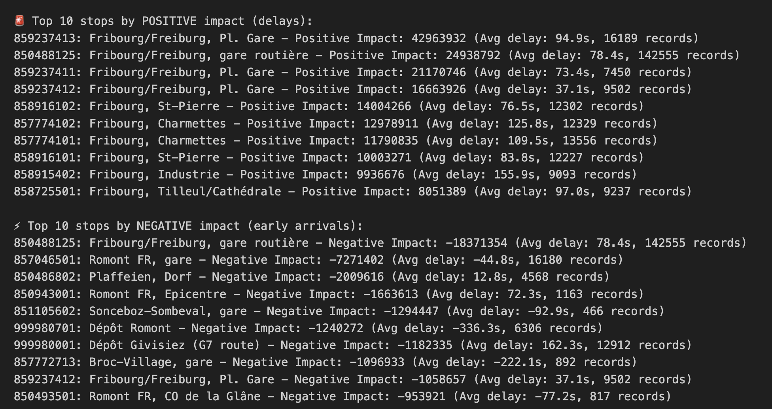
Rank the delay of stops and the responsible lines impact = ∑delays for each trip at a stop * (passengers on + off)

Slide 3
Only stops median delays
857054502: Ulmiz FR, Abzw. Lurtigen - 359.0s median delay (139 records)
857772001: Châtel-St-Denis, Les Moilles - 358.5s median delay (298 records)
858915002: Fribourg, Musy 4 - 325.0s median delay (4664 records)
857054402: Ulmiz FR, Ausserdorf - 324.5s median delay (128 records)
858881601: Tafers, Oberdorf - 321.0s median delay (1059 records)

Slide 4
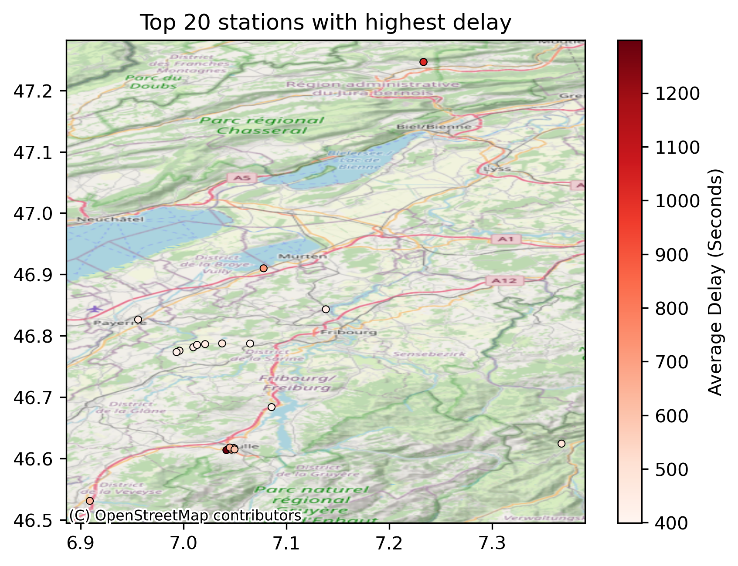
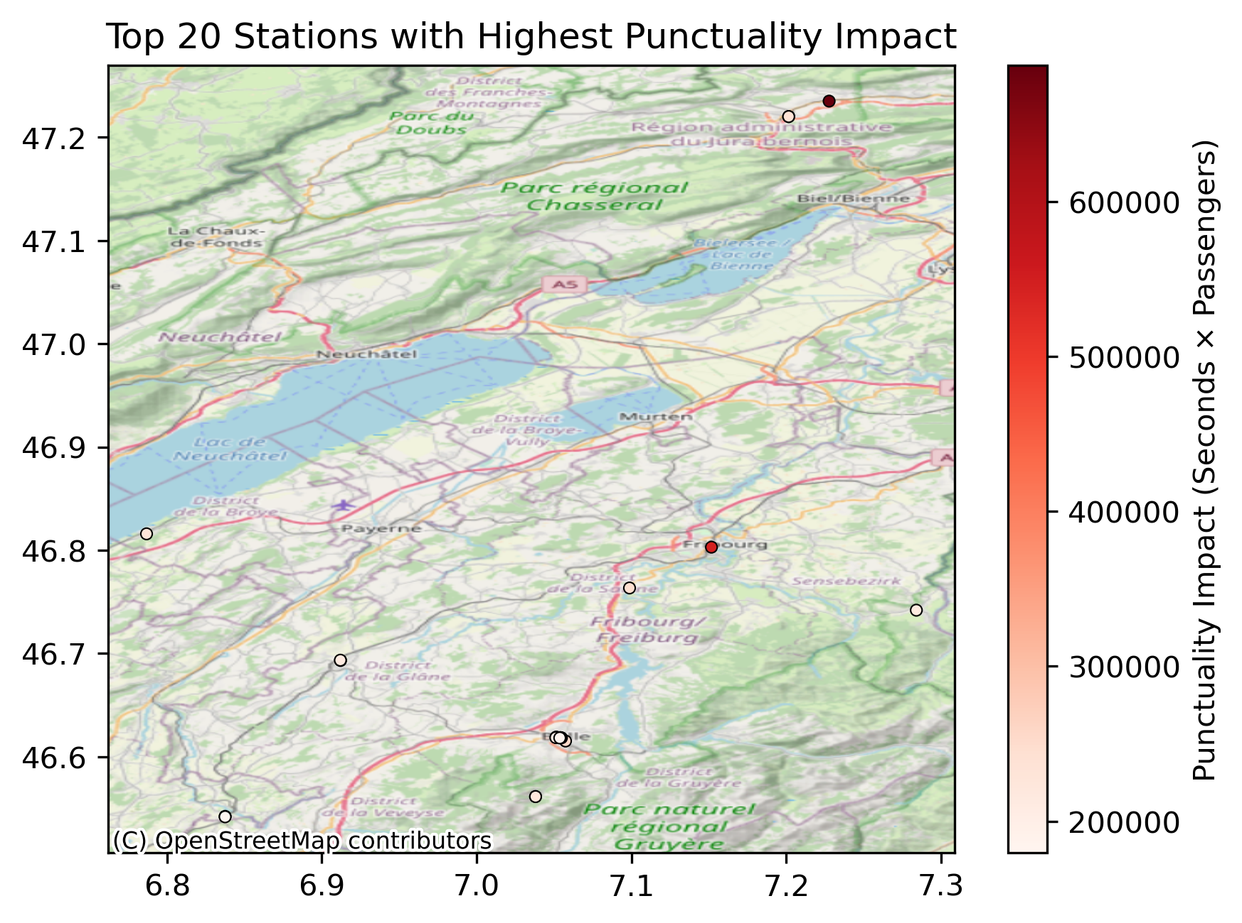

Slide 5
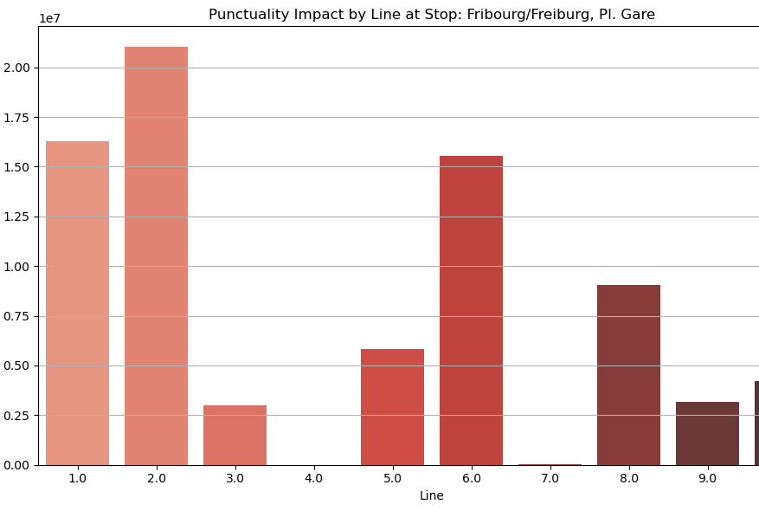
Fribourg/Freiburg, Pl. Gare

Slide 6
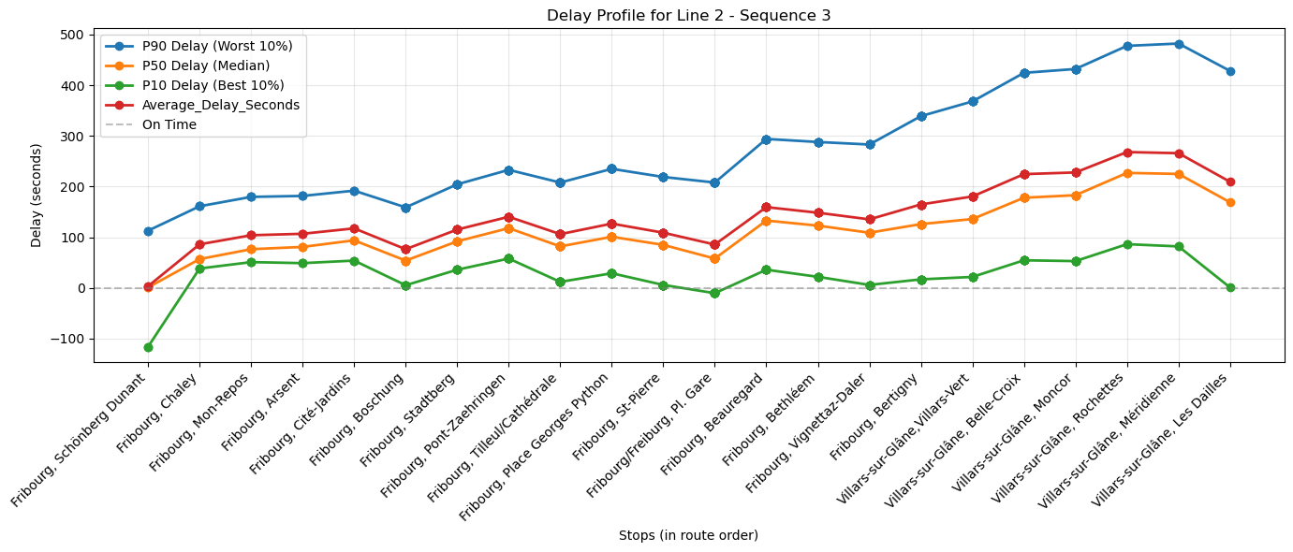
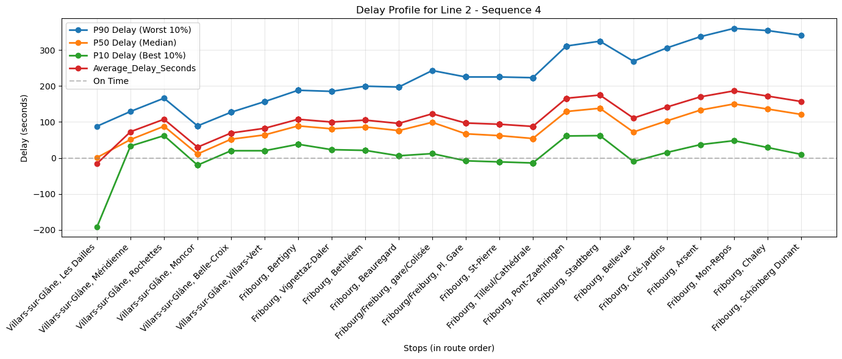
Line 2

Slide 7
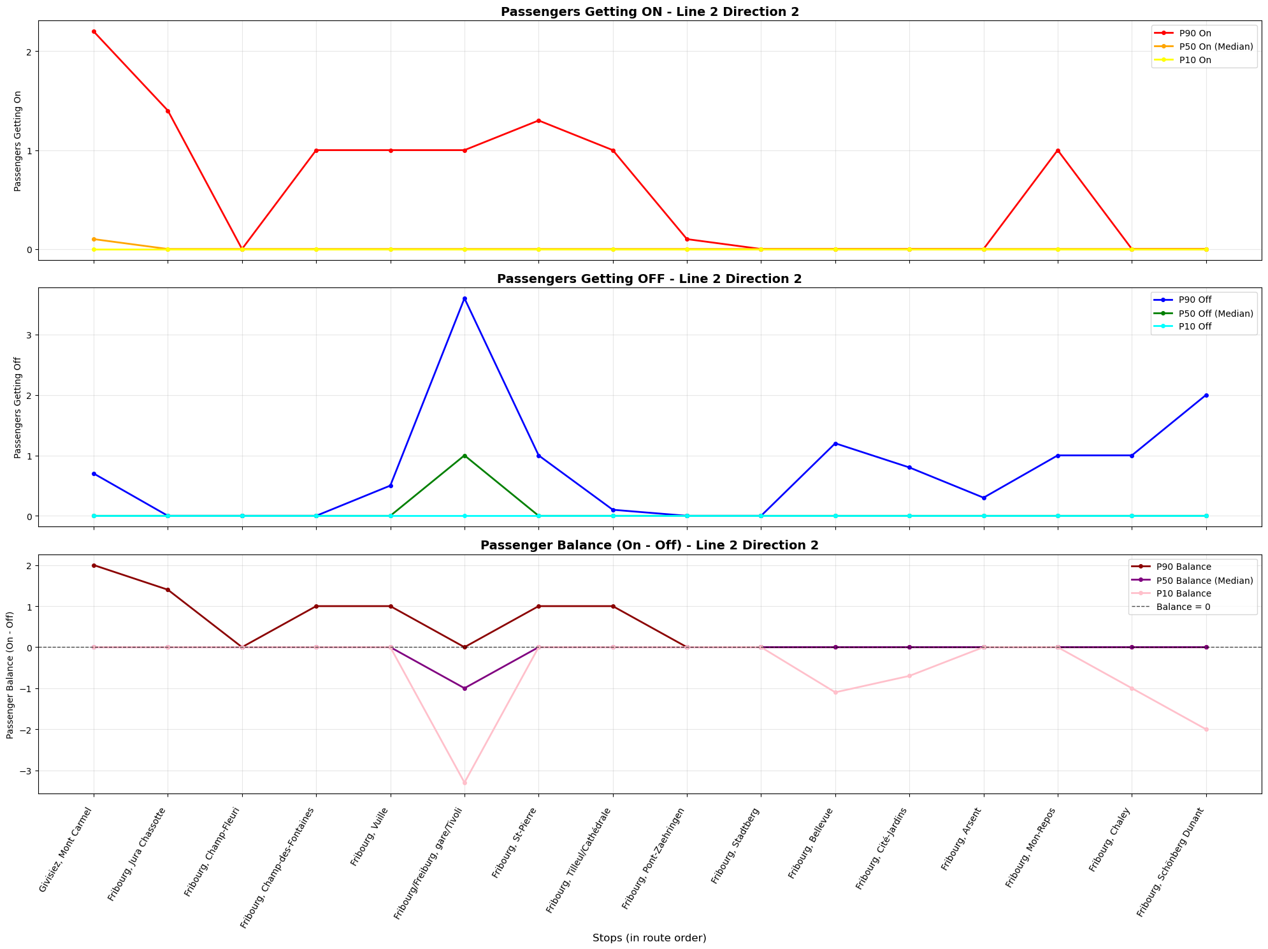

Slide 8
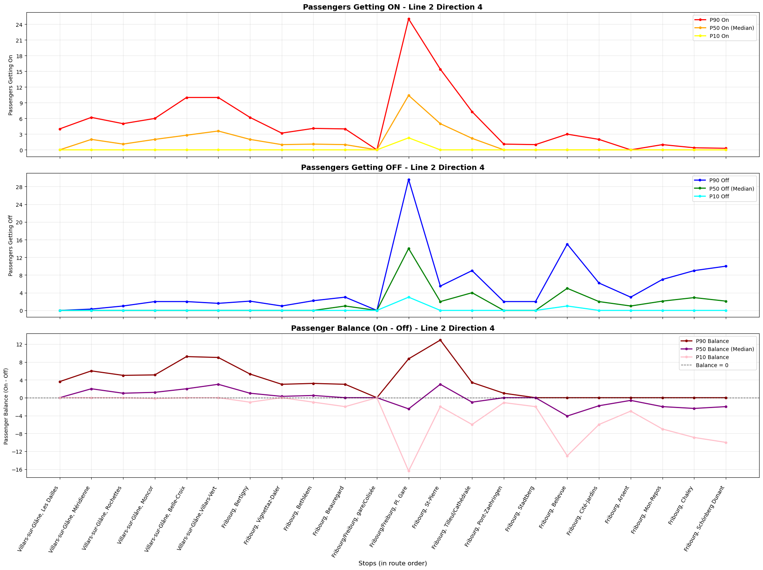

Slide 9
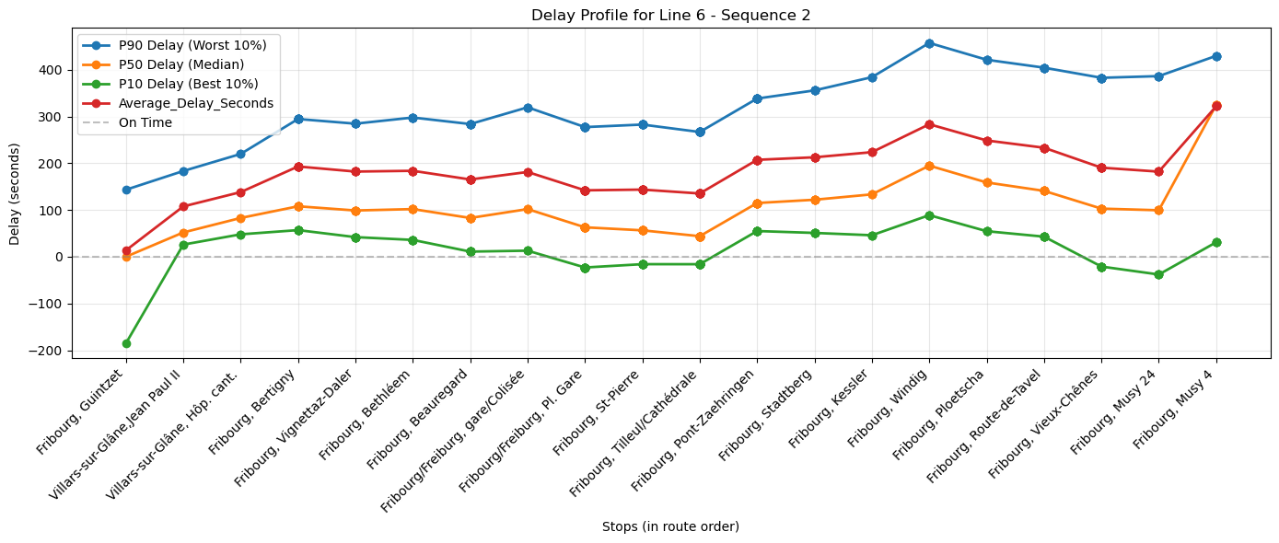
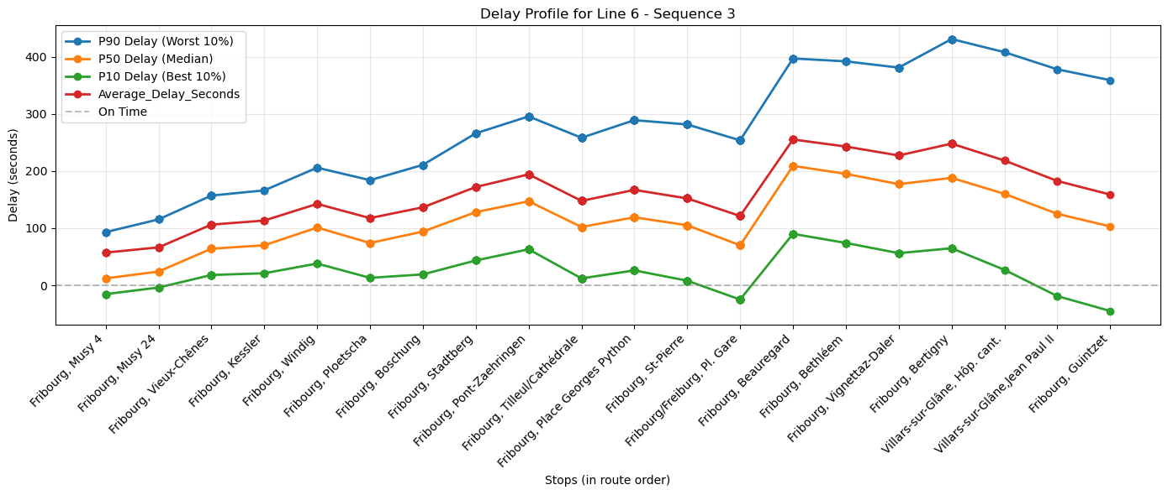
Line 6

Slide 10
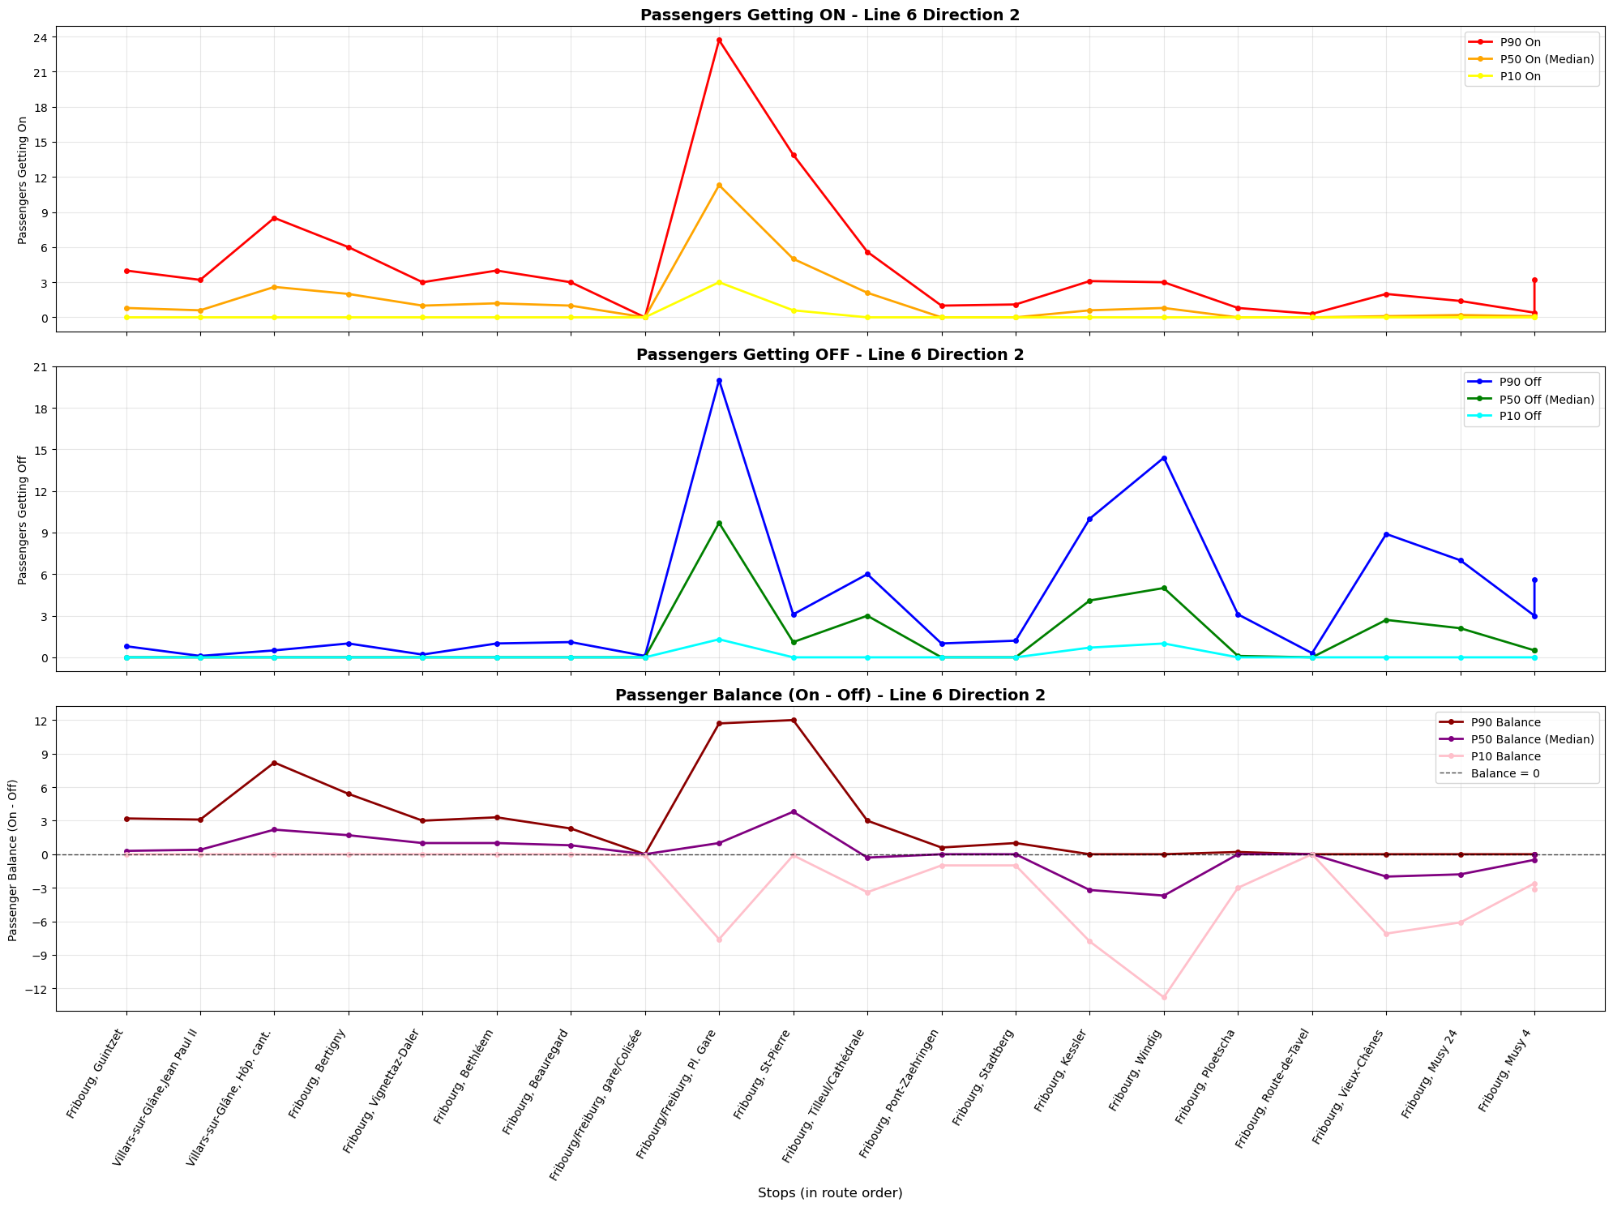

Slide 11
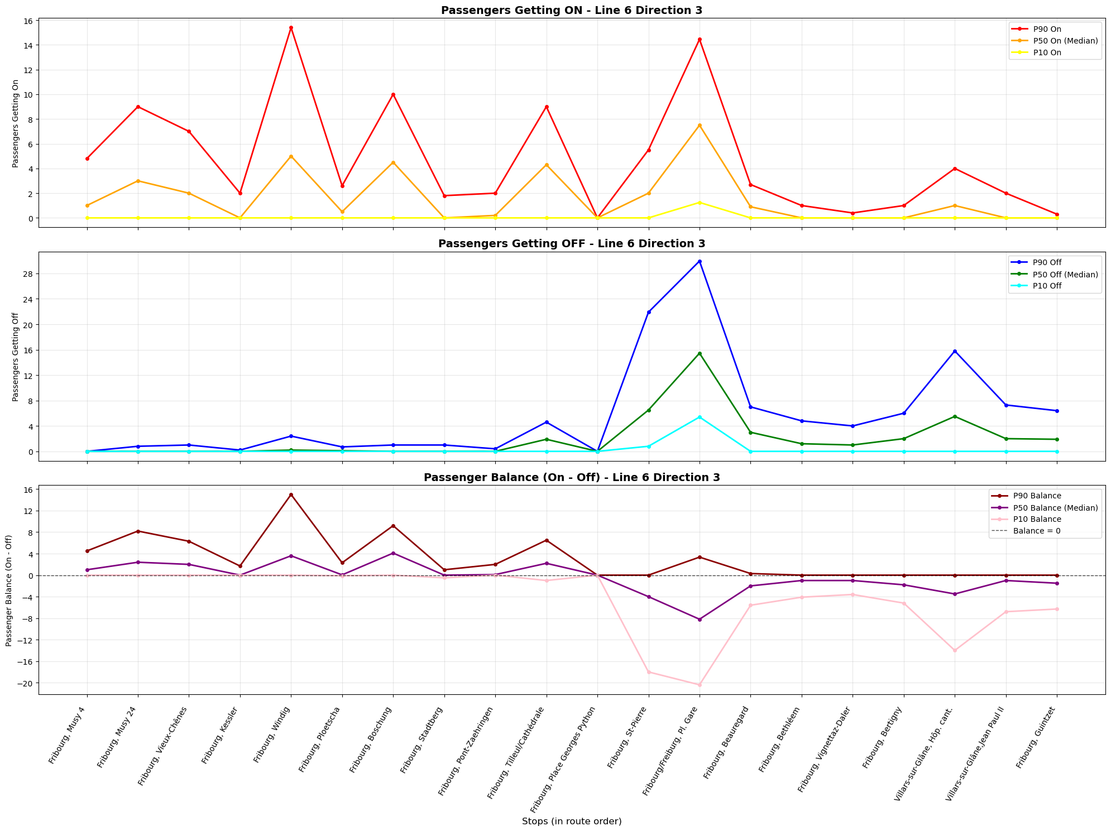

Slide 12
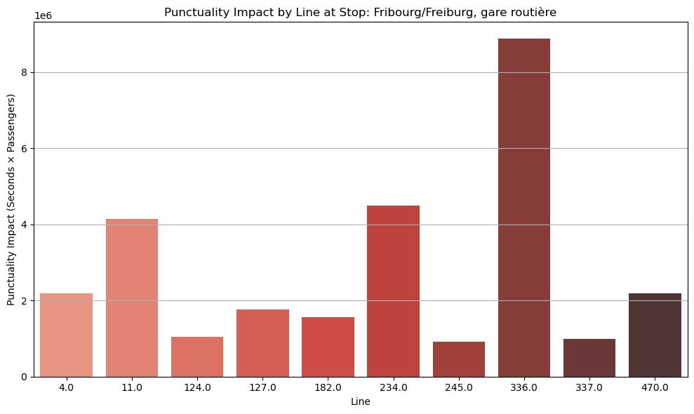
Fribourg/Freiburg, gare routière

Slide 13
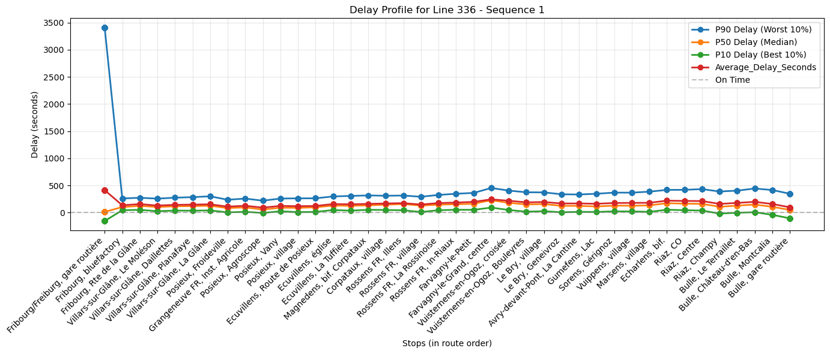
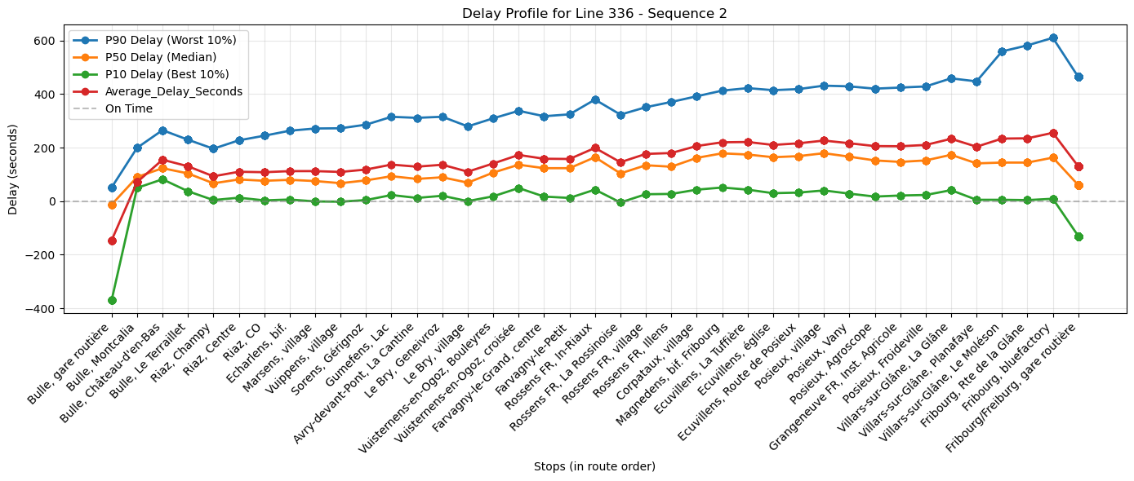
LINE 336

Slide 14
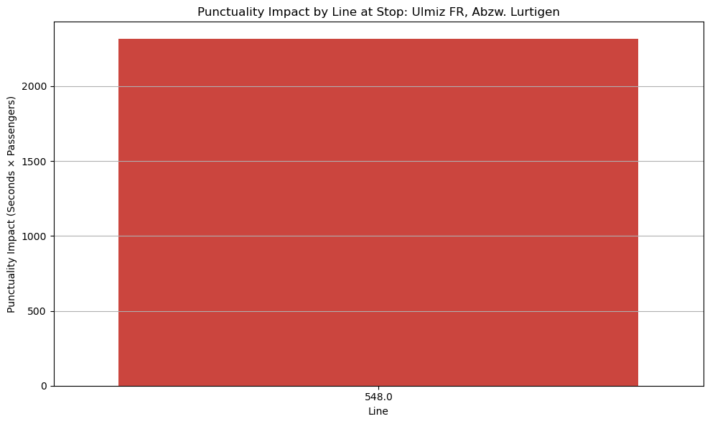
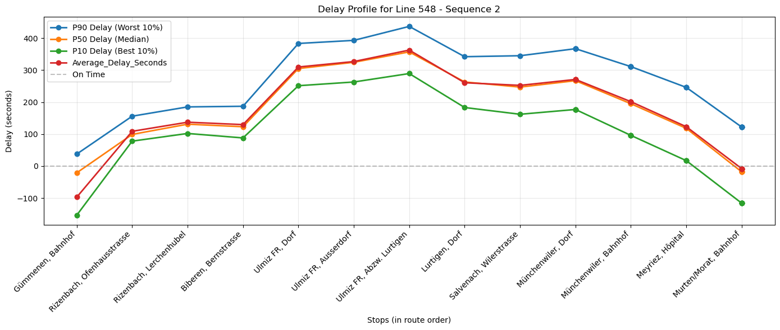
Ulmiz FR, Abzw. Lurtigen

Slide 15
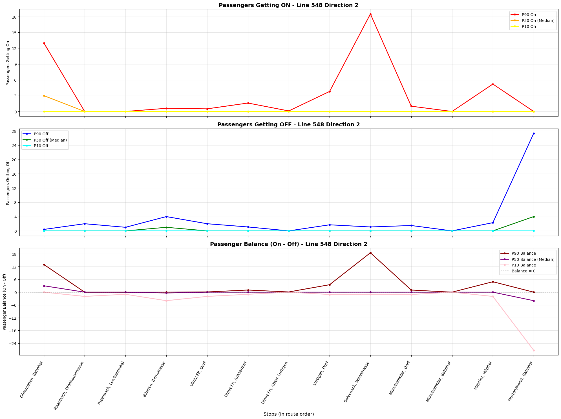

Slide 16
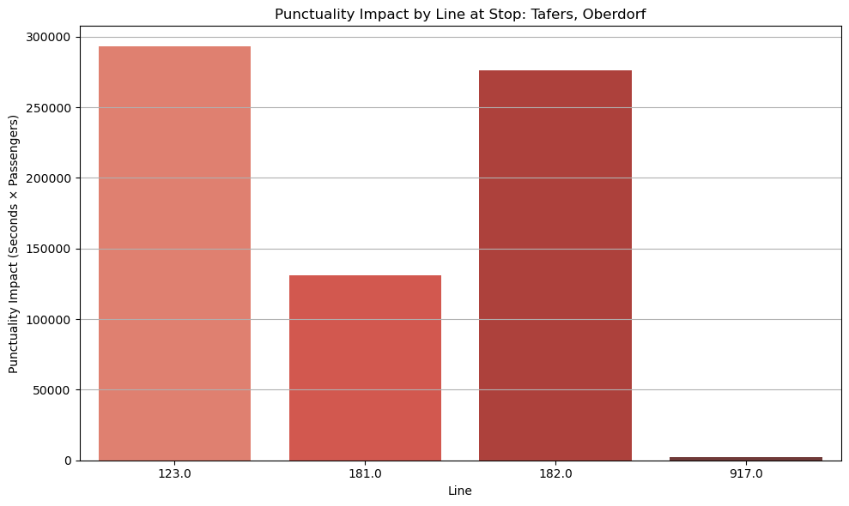
Tafers, Oberdorf

Slide 17
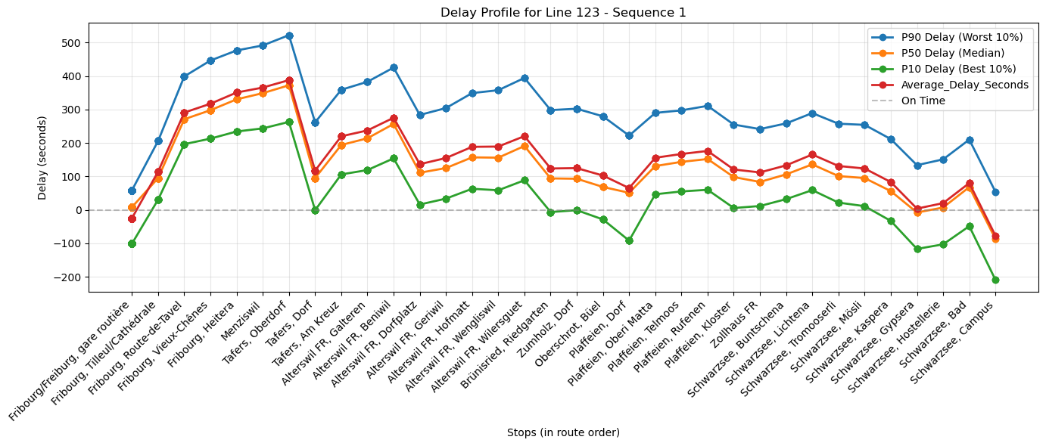
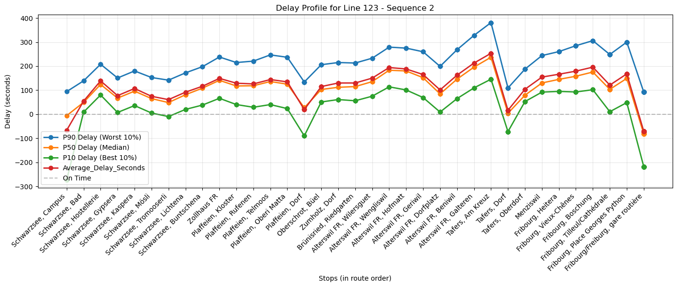
LINE 123

Slide 18
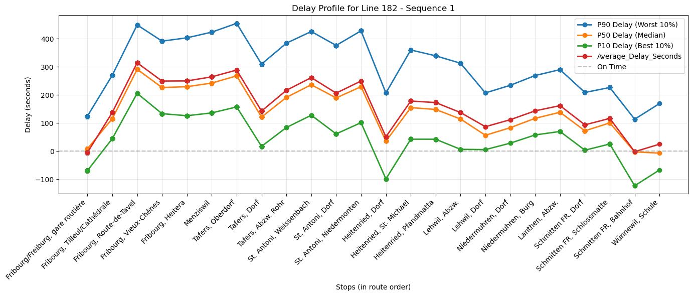
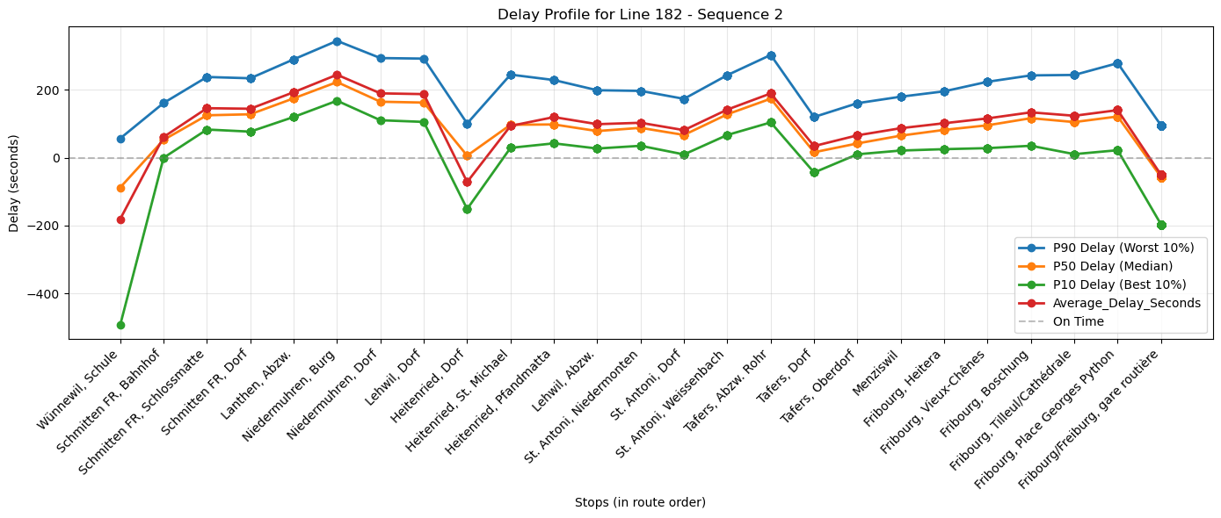
LINE 182

Slide 19
Avg delay-person: ∑ delay * (on+off) / ∑ (on+off)
850461101: Chésopelloz, village - 707.4s avg delay per person (12 total passengers, 157 records)
857776401: Boltigen, Bahnhof - 546.2s avg delay per person (956 total passengers, 236 records)
850488119: Fribourg/Freiburg, gare routière - 515.2s avg delay per person (8708 total passengers, 633 records)
859612104: Bouloz, Les Esserts - 514.7s avg delay per person (0 total passengers, 209 records)
850461601: Cournillens, village - 483.5s avg delay per person (684 total passengers, 280 records)

Slide 20
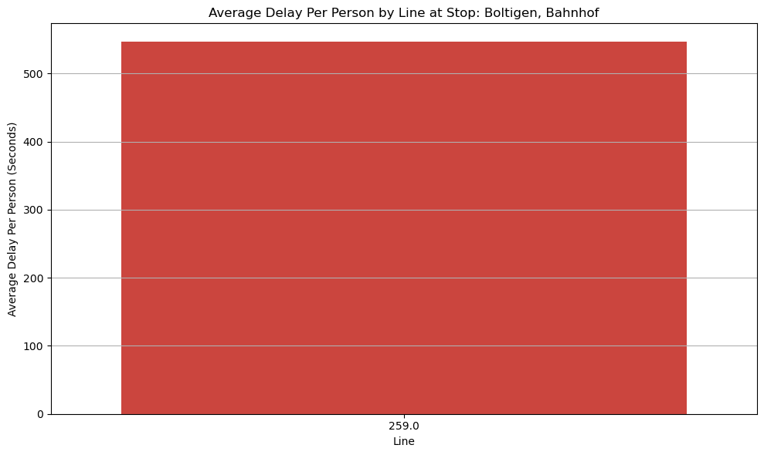
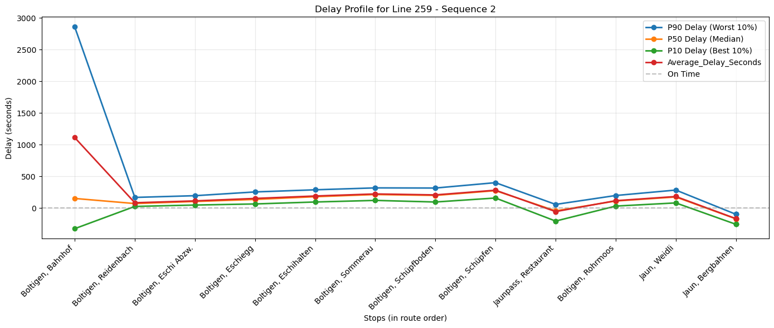
Boltigen, Bahnhof

